Slide 1











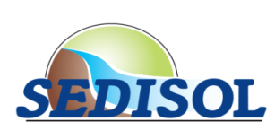


Environmental monitoring at a sediment source site to qualify for beneficial use
Valérie Laperche, Gabriel Billon, Bruno Lemière, Ludovic Lesven, Pierre Jean Superville, Marija Margus, Claire Alary, Olivier Bour, Mélanie Lefebvre, Pascal Auger, Mathieu Henry

Slide 2

When are on site characterisation technologies used on sediment valorisation projects?
On-site characterisation technologies can be profitably used at several stages:
during detailed sediment mapping prior to dredging,
during dredging operations, to allow a better management of each load, according to contamination and reuse suitability,
for selective storage and processing of sediments stocks on land,
during the application of reused sediments.
(Valorisation = Beneficial use)

Slide 3
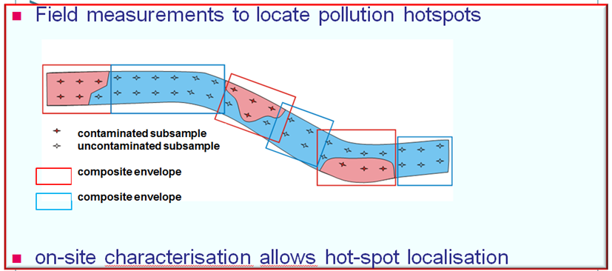
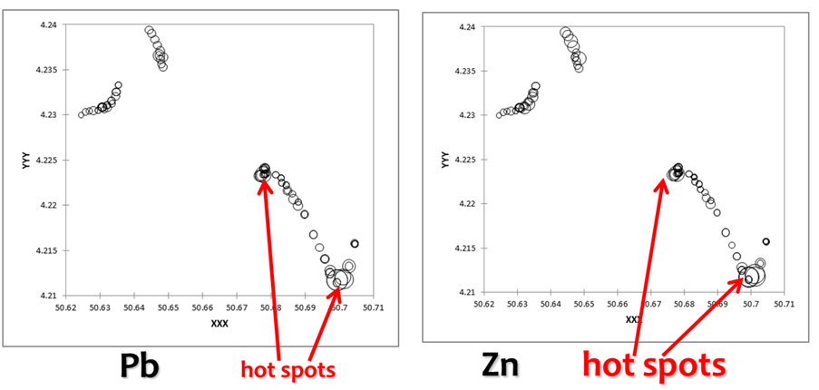
During detailed sediment mapping prior to dredging

Slide 4
When are on site characterisation technologies used on sediment valorisation projects?
On-site characterisation technologies can be profitably used at several stages:
during detailed sediment mapping prior to dredging,
during dredging operations, to allow a better management of each load, according to contamination and reuse suitability,
for selective storage and processing of sediments stocks on land,
during the application of reused sediments.
(Valorisation = Beneficial use)

Slide 5
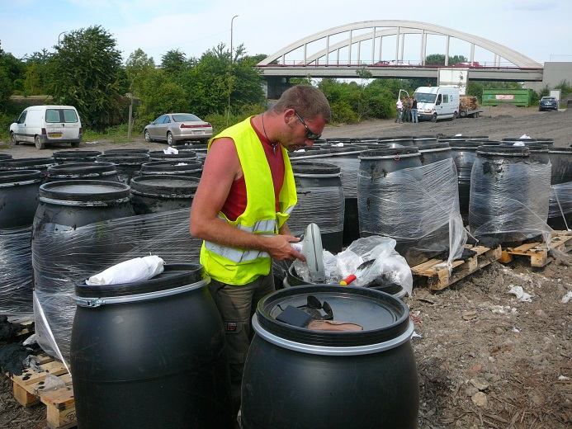
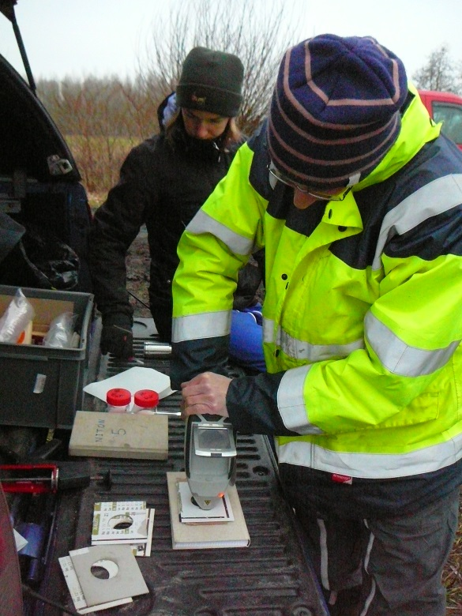
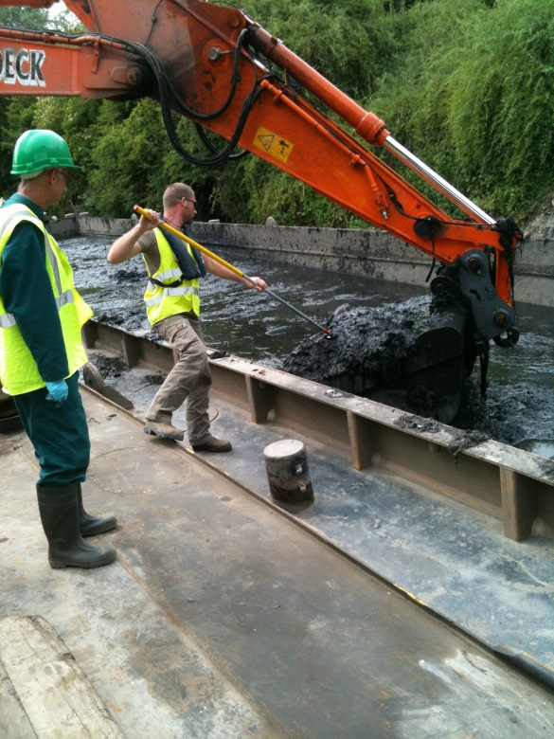
During dredging operations, to allow a better management of each load, according to contamination and reuse suitability

Slide 6
When are on site characterisation technologies used on sediment valorisation projects?
On-site characterisation technologies can be profitably used at several stages:
during detailed sediment mapping prior to dredging,
during dredging operations, to allow a better management of each load, according to contamination and reuse suitability,
for selective storage and processing of sediments stocks on land,
during the application of reused sediments.
(Valorisation = Beneficial use)

Slide 7
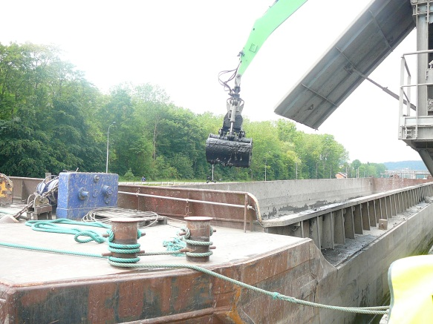
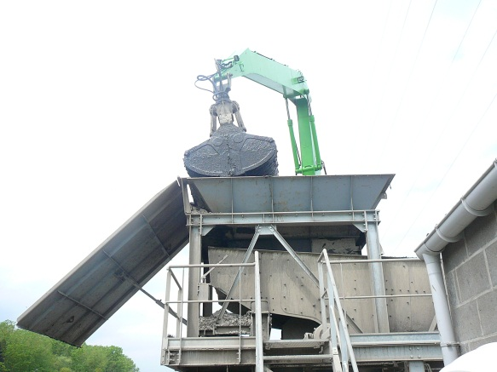
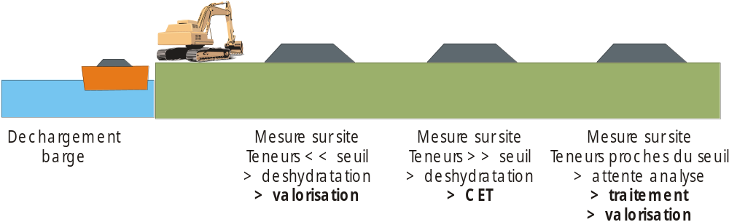
For selective storage and processing of sediments stocks on land
Required:
Quick on-site analysis of contamination
Sediment treatment facility on the canal or the port, or
Selective storage facility.
Unloading destination handling:
Low concentration valorisation
direct shipping
High concentration HW disposal
direct shipping
Near thresholds treatment unloading, storage

Slide 8
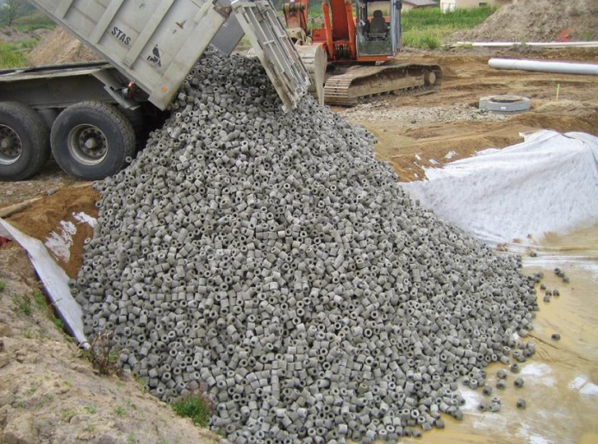
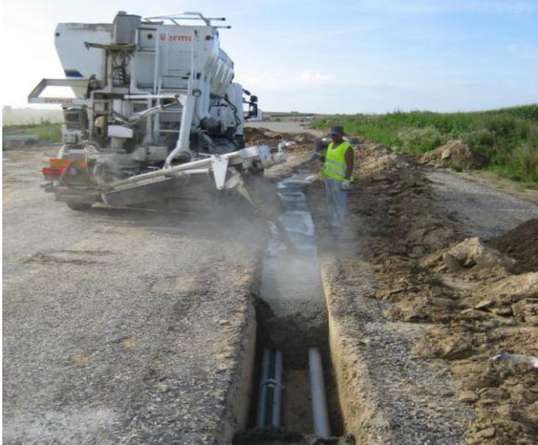
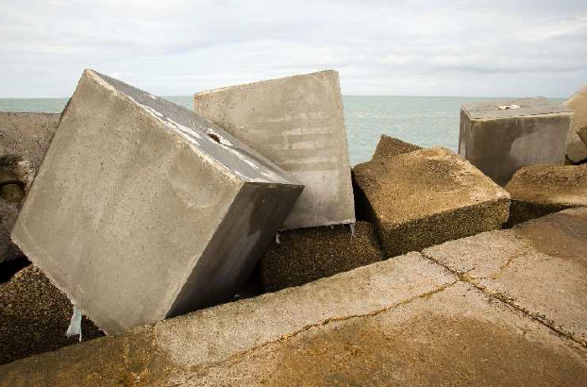
During the application of reused sediments, for checking:
the product homogeneity, and its suitability to the task,
its contaminant contents to ensure environmental safety,
and to provide public information on the long term behaviour of sediments, and on contaminants emissions from the works.
photos Lille Métropole/ Dunkirk port/ Sedilab

Slide 9
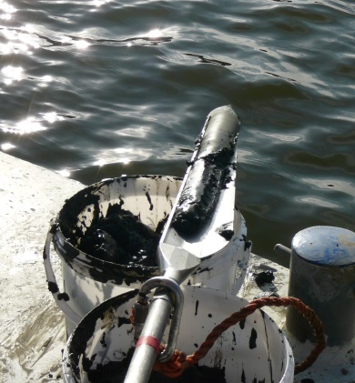
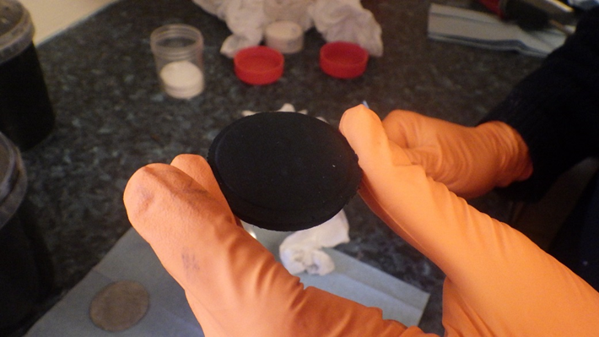
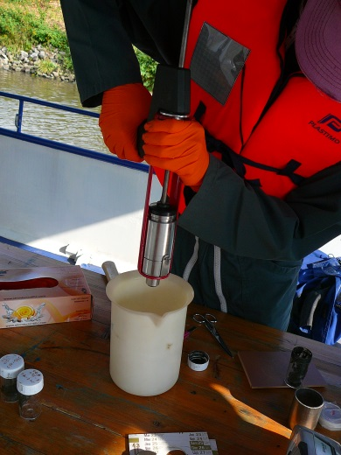
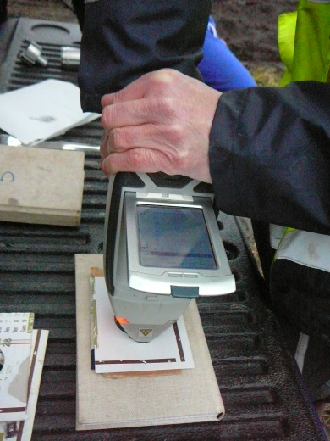
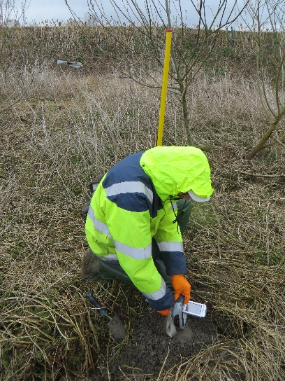
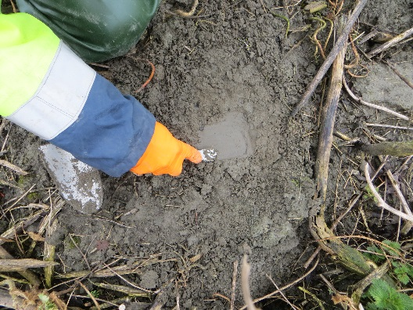
Technologies: pXRF
pXRF allows routine measurements for structural elements and for many inorganic contaminants,
pXRF sensitivity is sufficient for the discrimination of contaminated sediments,
sampling is done by traditional methods (auger coring…),
sample is partly dehydrated using a hand press for semi-liquid sediment,
pXRF analysis is performed immediately on the sample disc,
or on solid-sample, pXRF analysis is performed directly on the flat surface.

Slide 10
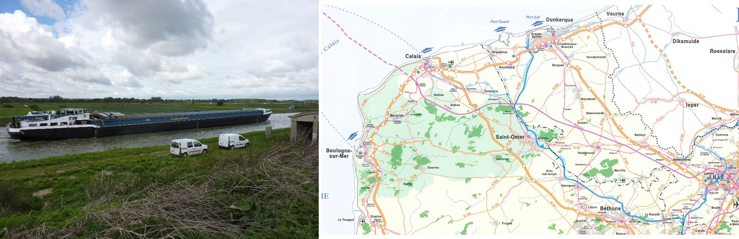
Case studies:
TD26, Saint Omer, France

Slide 11
TD26, Saint Omer: an historic disposal site for dredgings...
Sediments were dehydrated and maturated during decades in storage, becoming increasingly similar to soil.
High OM content grants fertility and hydraulic properties are desirable for water-related civil works (dikes, backfill, landscaping).
... Twenty years later, a stock of usable mineral matter.

Slide 12
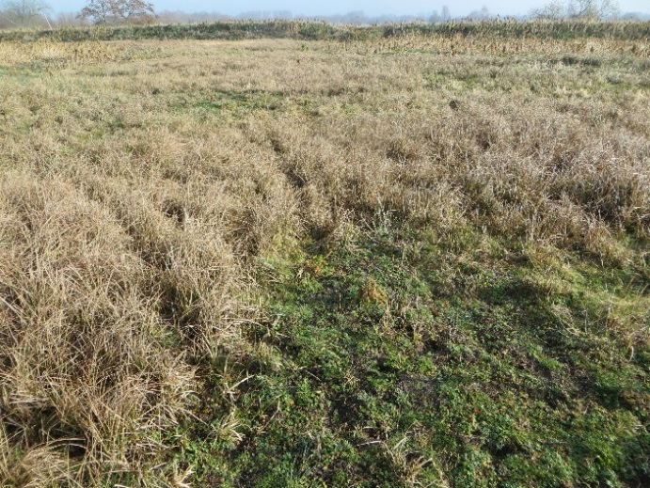
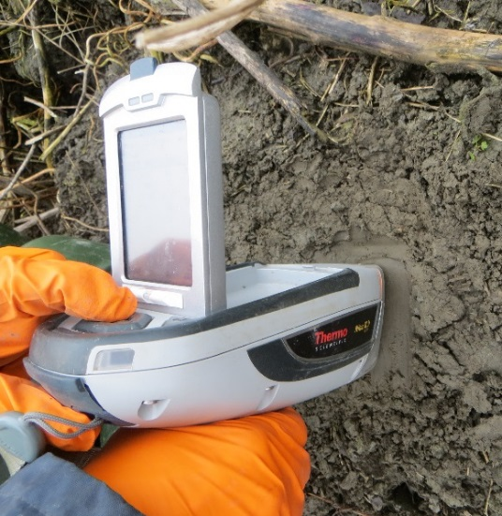
TD26, Saint Omer: Former sediment disposal site
Aims: To promote sustainable dredged sediment reuse (landscaping, cycle paths, dikes).
Mature sediment: 14 to 40 years old.
Sediments are now comparable to soil in terms of water content and mechanical behaviour.
Sediments were analysed similarly to raw soil with pXRF at < 15 m intervals.
No dehydration by filter press was needed to reach standard water contents (25-35%).

Slide 13
TD26, Saint Omer: Valorisation of sediments from old disposal sites for flood protection works
Hydraulic engineering is necessary for flood protection and climate change mitigation.
Dehydrated and maturated sediments from historic canal dredging can be used, but
Need to control chemical homogeneity before and during excavation to locate possible contamination hotspots.

Slide 14
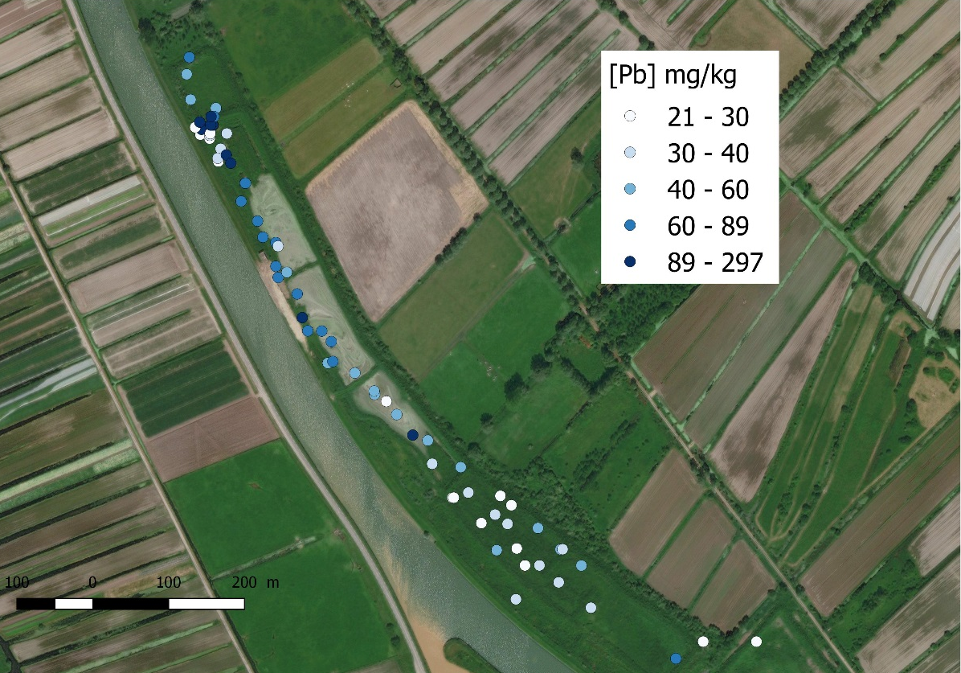
TD26, Saint Omer: Spatial variability of metals
 | As | Cu | Pb | Zn | Ca | Fe
Min | 5 | 15 | 20 | 47 | 2,7 | 0,5
Max | 40 | 114 | 297 | 623 | 16,9 | 2,2
Mean | 11 | 27 | 65 | 165 | 6,7 | 1,3
Q2 | 9 | 24 | 46 | 114 | 6,7 | 1,2
Raw data in mg/kg except for Ca and Fe in %
Sediments are generally homogeneous with Pb-Zn-Cr similar to target soils. Concentrations are higher on the north part of the storage cell (oldest area).

Slide 15
Relevance for circular economy
Valorisation (beneficial use) of dredged sediments is not yet routine practice, due to limitations in
  Operating costs,
  Environmental uncertainties, both on the short and long term,
  Societal issues (acceptability, community leaders responsibility),
On site characterisation technologies contribute to alleviate these limitations
  By reducing cost risks and environmental uncertainties through continuous measurements of sediment quality,
  By reducing environmental risks on the long term, through high density site monitoring,
  By reducing acceptability and community leaders responsibility issues through easier access to community monitoring, with immediate feedback.
Pilot projects provide opportunities to test circular economy options in real size and to community monitoring.

Slide 16
Benefits and lessons
Despite limitations due to waste status, sediment valorisation is an increasing alternative to minerals extraction for civil engineering,
Facilitate valorisation projects by allowing rapid on-site decisions,
Provide immediate data if mineral processing is required,
On-site, quasi real time results offer a significant advantage for daily operational decisions compared to more precise but lengthy and expensive laboratory work,
Expected outcome:
  an increase in sediment valorisation projects in NW Europe,
  development of a support industry, services and application sector.

